Slide 1
Datalink Outages Oakland Center Reported and Detected
ISPACG/34 FIT/27
July 28th – 29th, 2020
Prepared by: Julia Fuller

Slide 2
Overview
Reported Outages
Accuracy and Timeliness of Notifications
Controller Impact
Detected Outages
Controller Impact
Upcoming ATOP changes to improve the handling of outages
Network Outage Detection and Reporting(NODAR) Project Team

Slide 3
Satellite Service Provider (SSP) | Satellite | Service | Ground Station Location | ARINC ACARS Identifiers | SITA ACARS Identifiers
Iridium | All | Short Burst Data | Primary: Tempe, Arizona, US Secondary: None | IG1 - 2 | IGW1 - 8
Inmarsat | AORE (3F5 at 54°W) | Classic Aero | Burum, Netherlands | XXN - 15 | AOE6 - 14
 |  | Swift Broadband-Safety | N/A | N/A | N/A
 | EMEA (AF1 at 25°E) | Classic Aero over I-4 | Primary: Fucino, Italy Secondary: Burum, Netherlands | XXF | EUA1
 |  | Classic Aero over I-4 (virtual I-3 IOR) | Burum, Netherlands | XXI | EUA2
 |  | Swift Broadband-Safety | Primary: Burum, Netherlands Secondary: Fucino, Italy | XXB | EUA9
 | APAC (4F1 at 143.5°E) | Classic Aero over I-4 | Primary: Paumalu, Hawaii, US Secondary: Auckland, New Zealand | XXA - 4 | APK1 -1
 |  | Classic Aero over I-4 (virtual I-3 POR) | Perth, Australia | XXP - 7 | APK2 - 10
 |  | Swift Broadband-Safety | Primary: Paumalu, Hawaii, US Secondary: Auckland, New Zealand | XXS -16 | APK9
 | AMER (4F3 at 98°W) | Classic Aero over I-4 | Primary: Paumalu, Hawaii, US Secondary: Auckland, New Zealand | XXH - 3 | AME1 - 5
 |  | Classic Aero over I-4 (virtual I-3 AORW) | Laurentides, Canada | XXW - 6 | AME2 -9
 |  | Swift Broadband-Safety | Primary: Paumalu, Hawaii, US Secondary: Laurentides, Canada | XXU - 11 | AMR9
 | MEAS (4F2 at 64°E) | Swift Broadband-Safety | Primary: Burum, Netherlands Secondary: Fucino, Italy | XXM | MEA9
MTSAT |  |  | Kobe and Hitachiota, Japan | N/A | MTS1 – 13(Feb-6)

Slide 5
Reported Outages

Slide 6
Reported Outages No Observed Impact
CSP Notification details |  |  |  |  |  | Impact details
Start Date | Start Time (UTC) | Duration (min) | Service Impacted | Satellite Region Impacted | Source | Path ID | Total reports | Delay > 180 sec | Total flights | Impacted flights | Total uplinks on Path | MAS failures | No MAS Received
7-Feb-20 | 01:42 | 9.00 | Inmarsat Voice and Data Services | AMER | SITA | AME1 | 13 | 0 | 11 | 0 | 3 | 0 | 0
 |  |  |  |  |  | AME2 | 3 | 0 | 2 | 0 | 0 | 0 | 0
19-Apr-20 | 15:26 | 60.00 | Inmarsat Voice and Data Services/No End Time Provided | AMER(AME1 & AME2) | SITA | AME1 | 46 | 0 | 7 | 0 | 7 | 0 | 0
 |  |  |  |  |  | AME2 | 5 | 0 | 1 | 0 | 5 | 0 | 0
19-Apr-20 | 15:32 | 129.00 | Classic Aero over I4 and SB Safety Data and ACARS | I-4 AMER | ARINC | XXH | 48 | 0 | 6 | 0 | 15 | 1 | 0
 |  |  |  |  |  | XXW | 55 | 0 | 4 | 0 | 7 | 1 | 0
15-May-20 | 01:13 | 84.00 | Classic Aero over I3 | POR | ARINC | XXP | 29 | 0 | 4 | 0 | 19 | 0 | 0
~1.5 hours after the reported Feb 7th outage, an unreported outage/degradation was detected in the same region
For the reported April 19th outage, no end time was provided. One hour was used as the duration estimate to check the data for delayed messages and MAS Failures.

Slide 7
Reported Outages Low/Moderate Impact
CSP Notification details |  |  |  |  |  | Impact details
Start Date | Start Time (UTC) | Duration (min) | Service Impacted | Satellite Region Impacted | Source | Path ID | Total reports | Delay > 180 sec | Total flights | Impacted flights | Total uplinks on Path | MAS failures | No MAS Received
18-Mar-20 | 15:52 | 55.00 | Inmarsat | Pamalau, Hawaii | ARINC | XXA | 3 | 1 | 3 | 1 | 0 | 32 | 0
117 Outage Related Sector Queue messages were observed
Delays were observed over APK2 were observed during this time period, however no notification was received from SITA regarding an outage over APK2
The first outage notification was received 8 minutes after the conclusion of the outage

Slide 8
Reported Outages Moderate/Significant Impact
CSP Notification details |  |  |  |  |  | Impact details
Start Date | Start Time (UTC) | Duration (min) | Service Impacted | Satellite Region Impacted | Source | Detected/Reported | Path ID | Start Time | End Time | Duration (min) | Total reports | Delay > 180 sec | Total flights | Impacted flights | Total uplinks on Path | MAS failures
22-Jan-20 | 02:00 | 282.00 | Inmarsat | APAC and POR | ARINC | Reported | XXA | 02:00:00 | 06:42:00 | 282.00 | 26 | 1 | 7 | 1 | 9 | 227
 |  |  |  |  |  | Reported | XXP | 02:00:00 | 06:42:00 | 282.00 | 472 | 87 | 34 | 15 | 217 | 227
 |  |  |  |  |  | Detected | XXP | 04:42:35 | 05:06:32 | 24.00 | 41 | 11 | 14 | 5 | 22 | 18
CSP Notification details |  |  |  |  |  |  |  | Impact details
Start Date | Start Time (UTC) | Duration (min) | Service Impacted | Satellite Region Impacted |  | Source |  | Detected/Reported | Path ID | Start Time | End Time | Duration (min) | Total reports | Delay > 180 sec | Total flights | Impacted flights | Total uplinks on Path | MAS failures
22-Jan-20 | No CSP Reports/Degradation |  |  |  |  |  |  | Detected | AME1 | 00:33:30 | 00:52:45 | 20.00 | 41 | 16 | 21 | 14 | 6 | 25
22-Jan-20 | No CSP Reports/Degradation |  |  |  |  |  |  | Detected | APK2 | 02:44:04 | 03:40:07 | 57.00 | 33 | 21 | 9 | 6 | 19 | 35
Delayed messages were observed intermittently during the duration of the outage
Mas Failures for uplinks were the most significant impact of the outage
The Outage notification was received ~two hours after the conclusion of the outage

Slide 9
Reported Outages Moderate/Significant Impact
CSP Notification details |  |  |  |  |  | Impact details
Start Date | Start Time (UTC) | Dur (min) | Service Impacted | Satellite Region Impacted | Source | Detected Reported | Path ID | Start Time | End Time | Dur (min) | Total reports | Delay > 180 sec | Total flights | Impacted flights | Total uplinks on Path | MAS failures | Outage Related Sector Queue Messages
6-Feb-20 | 23:05 | 50.00 | Iridium | Global | SITA | Detected | IGW1 | 21:58:42 | 22:19:48 | 22.00 | 43 | 25 | 13 | 13 | 17 | 17 | 92
 |  |  |  |  |  | Detected | IGW1 | 23:26:33 | 23:58:58 | 33.00 | 21 | 12 | 10 | 5 | 31 | 32 | 291
 |  |  |  |  |  | Reported | IGW1 | 23:05:00 | 23:55:00 | 50.00 | 17 | 12 | 9 | 5 | 22 | 97 | 529
6-Feb-20 | 23:43 | 12.00 | Iridium | Global | ARINC | Detected | IG1 | 21:59:23 | 22:21:29 | 23.00 | 114 | 71 | 33 | 29 | 31 | 17 | 95
 |  |  |  |  |  | Detected | IG1 | 22:58:43 | 00:18:10 | 80.00 | 184 | 114 | 36 | 31 | 87 | 103 | 591
 |  |  |  |  |  | Reported | IG1 | 23:43:00 | 23:55:00 | 12.00 | 49 | 33 | 22 | 16 | 38 | 0 | 529
Delayed messages and MAS Failures were observed prior to the reported start of the outage
Mas Failures for uplinks were a significant impact of this outage
The Outage notification was received 20 minutes after the conclusion of the outage but 3 hours after the start of the detected outage

Slide 10
Reported Outages Moderate/Significant Impact
CSP Notification details |  |  |  |  |  | Impact details
Start Date | Start Time (UTC) | Dur (min) | Service Impacted | Satellite Region Impacted | Source | Detected Reported | Path ID | Start Time | End Time | Dur (min) | Total reports | Delay > 180 sec | Total flights | Impacted flights | Total uplinks on Path | MAS failures |  | Outage Related SQ Msgs
11-Feb-20 | 18:06 | 37.00 | Iridium | Global | SITA | Detected | IGW1 | 18:45:14 | 19:03:25 | 19.00 | 10 | 8 | 3 | 2 | 9 | 0 |  | 59
 |  |  |  |  |  | Reported | IGW1 | 18:06:00 | 18:43:00 | 37.00 | 4 | 4 | 1 | 1 | 1 | 55 |  | 248
11-Feb-20 | No CSP Reports/Degradation |  |  |  |  | Detected | IG1 | 18:03:58 | 19:00:33 | 57.00 | 79 | 47 | 19 | 17 | 32 |  | 55 | 330
The outage notification was received within 5 minutes of the conclusion of the outage
An outage notification was only received from SITA, however, impact was also observed over the ARINC Iridium path id – IG1

Slide 11
Reported Outages Significant Impact
CSP Notification details |  |  |  |  |  | Impact details
Start Date | Start Time (UTC) | Dur (min) | Service Impacted | Satellite Region Impacted | Source | Detected Reported | Path ID | Start Time | End Time | Dur (min) | Total reports | Delay > 180 sec | Total flights | Impacted flights | Total uplinks on Path | MAS failures | Outage Related SQ Msgs
7-Feb-20 | 01:42 | 9.00 | Inmarsat | AMER | SITA | Reported | AME1 | 01:42:00 | 01:51:00 | 9.00 | 13 | 0 | 11 | 0 | 3 | 0 | 2
 |  |  |  |  |  | Reported | AME2 | 01:42:00 | 01:51:00 | 9.00 | 3 | 0 | 2 | 0 | 0 | 0 | 2
7-Feb-20 | No CSP Reports/Degradation |  |  |  |  | Detected | AME1 | 03:26:21 | 03:53:59 | 28.00 | 23 | 11 | 7 | 5 | 11 | 0 | 9
 |  |  |  |  |  | Detected | AME1 | 05:08:37 | 05:30:06 | 22.00 | 25 | 15 | 8 | 8 | 12 | 2 | 29
 |  |  |  |  |  | Detected | XXH | 05:10:51 | 05:31:49 | 21.00 | 29 | 15 | 8 | 6 | 18 | 2 | 28
 |  |  |  |  |  | Detected | XXH | 06:26:37 | 06:43:20 | 17.00 | 12 | 7 | 6 | 5 | 8 | 0 | 2
 |  |  |  |  |  | Detected | AME1 | 06:52:21 | 08:00:28 | 69.00 | 92 | 50 | 17 | 15 | 89 | 9 | 126
 |  |  |  |  |  | Detected | XXH | 06:54:17 | 07:49:39 | 56.00 | 31 | 21 | 9 | 7 | 29 | 9 | 105
7-Feb-20 | 08:30 | 288.00 | Inmarsat | AMER | SITA | Detected | AME1 | 08:13:21 | 09:39:51 | 87.00 | 116 | 62 | 29 | 21 | 91 | 47 | 292
 |  |  |  |  |  | Detected | AME2 | 08:42:10 | 08:54:26 | 13.00 | 28 | 8 | 16 | 6 | 10 | 18 | 87
 |  |  |  |  |  | Detected | AME1 | 09:54:40 | 10:54:58 | 61.00 | 14 | 10 | 6 | 4 | 8 | 90 | 402
 |  |  |  |  |  | Reported | AME1 | 08:30:00 | 13:18:00 | 288.00 | 121 | 55 | 25 | 16 | 72 | 216 | 999
7-Feb-20 | No CSP Reports/Degradation |  |  |  |  | Detected | XXH | 08:06:07 | 09:39:14 | 94.00 | 74 | 39 | 15 | 10 | 57 | 47 | 298
7-Feb-20 | 10:17 | 186.00 | Classic Aero over I4 | AMER | ARINC | Detected | XXH | 09:57:12 | 10:23:39 | 27.00 | 18 | 14 | 7 | 5 | 16 | 42 | 216
 |  |  |  |  |  | Reported | XXH | 10:17:00 | 13:23:00 | 186.00 | 8 | 3 | 6 | 1 | 9 | 132 | 571
 |  |  |  |  |  | Reported | XXW | 10:17:00 | 13:23:00 | 186.00 | 669 | 3 | 55 | 3 | 145 | 132 | 571
Impact was observed outside of the time period of the outage notification

Slide 12
Reported Outages Significant Impact
CSP Notification details |  |  |  |  |  | Impact details
Start Date | Start Time (UTC) | Dur (min) | Service Impacted | Satellite Region Impacted | Source | Detected Reported | Path ID | Start Time | End Time | Dur (min) | Total reports | Delay > 180 sec | Total flights | Impacted flights | Total uplinks on Path | MAS failures | No MAS Received | Outage Related SQ Msgs
20-Feb-20 | 14:40 | 50.00 | Inmarsat ARINC Server Issue | Oceanic Regions | SITA | Detected | APK1 | 14:23:52 | 14:37:46 | 14.00 | 67 | 53 | 35 | 35 | 7 | 0 | 111 | 199
 |  |  |  |  |  | Detected | AME1 | 14:24:09 | 14:38:01 | 14.00 | 39 | 31 | 21 | 21 | 1 | 0 | 111 | 210
 |  |  |  |  |  | Detected | IGW1 | 14:25:09 | 14:37:55 | 13.00 | 10 | 7 | 5 | 5 | 0 | 0 | 106 | 204
 |  |  |  |  |  | Detected | APK2 | 14:25:16 | 14:37:16 | 13.00 | 13 | 10 | 8 | 7 | 0 | 0 | 106 | 185
 |  |  |  |  |  | Detected | APK1 | 14:51:16 | 15:27:05 | 36.00 | 174 | 157 | 43 | 40 | 12 | 10 | 308 | 791
 |  |  |  |  |  | Detected | IGW1 | 14:51:51 | 15:26:48 | 35.00 | 25 | 21 | 5 | 5 | 1 | 9 | 308 | 786
 |  |  |  |  |  | Detected | APK2 | 14:51:59 | 15:26:50 | 35.00 | 21 | 18 | 5 | 5 | 1 | 8 | 308 | 786
 |  |  |  |  |  | Detected | AME2 | 14:52:35 | 15:26:12 | 34.00 | 22 | 20 | 6 | 6 | 0 | 0 | 308 | 761
 |  |  |  |  |  | Detected | AME1 | 14:52:57 | 15:27:09 | 35.00 | 83 | 73 | 20 | 20 | 5 | 0 | 307 | 786
 |  |  |  |  |  | Reported | IGW1 | 14:40:00 | 15:30:00 | 50.00 | 33 | 21 | 5 | 5 | 2 | 11 | 308 | 1056
 |  |  |  |  |  | Reported | APK1 | 14:40:00 | 15:30:00 | 50.00 | 248 | 157 | 43 | 40 | 53 | 11 | 308 | 1056
 |  |  |  |  |  | Reported | APK2 | 14:40:00 | 15:30:00 | 50.00 | 34 | 18 | 9 | 5 | 12 | 11 | 308 | 1056
 |  |  |  |  |  | Reported | AME1 | 14:40:00 | 15:30:00 | 50.00 | 123 | 73 | 22 | 20 | 18 | 11 | 308 | 1056
 |  |  |  |  |  | Reported | AME2 | 14:40:00 | 15:30:00 | 50.00 | 33 | 20 | 6 | 6 | 0 | 11 | 308 | 1056
The outage started ~20 minutes prior to the reported time in the notification
KZWY declared ATC Alert during this outage

Slide 13
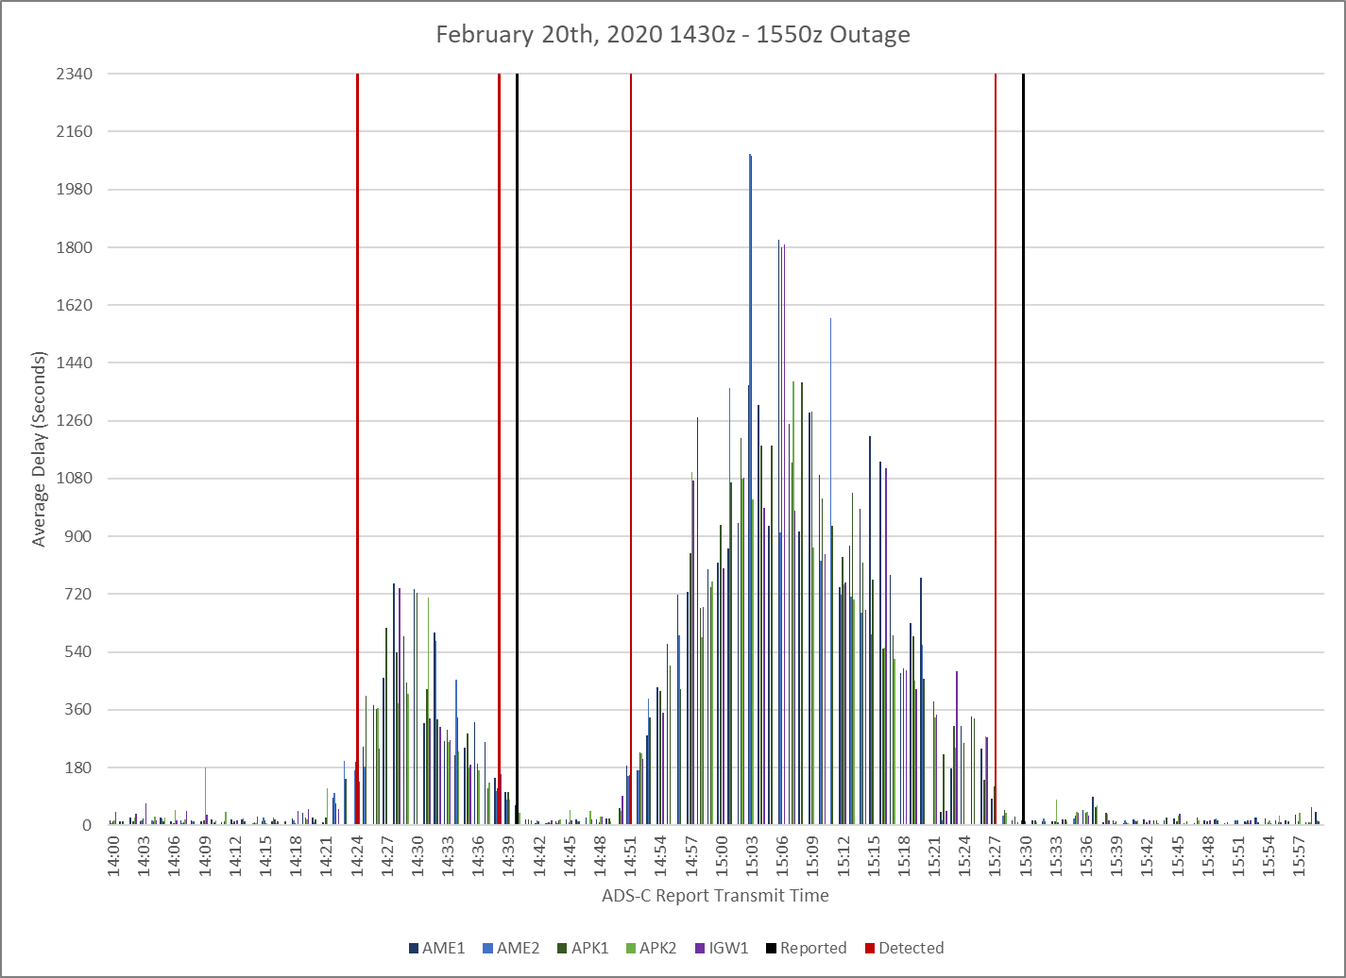
Reported Outages ADS-C Latency by GES

Slide 14
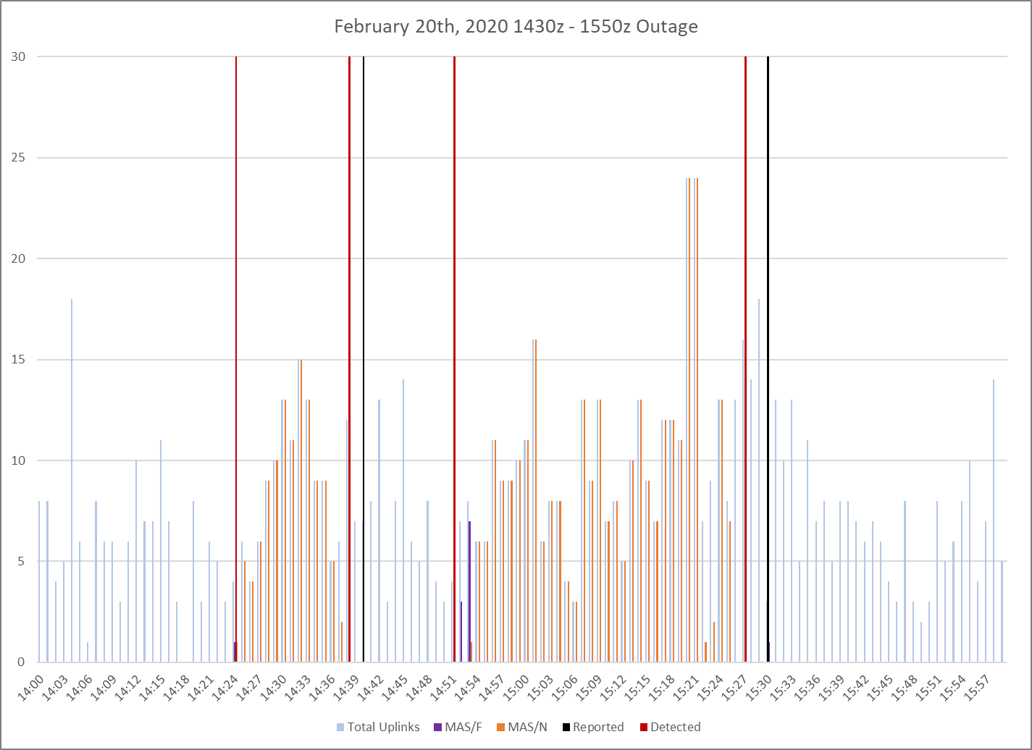
Reported Outages Uplink Delivery and MAS Response

Slide 15
Unreported Outages

Slide 16
Unreported Outages Low/Moderate Impact
CSP Notification details |  | Impact details
Start Date |  | DetectedReported | Path ID | Start Time | End Time | Duration (min) | Total reports | Delay > 180 sec | Total flights | Impacted flights | Total uplinks on Path | MAS failures | Outage Related Sector Queue Messages
31-Jan-20 | No CSP Reports/Degradation | Detected | XXW | 19:57:06 | 20:09:48 | 13.00 | 25 | 8 | 13 | 6 | 7 | 3 | 25
1-Jul-20 | No CSP Reports/Degradation | Detected | XXP | 15:10:08 | 15:35:32 | 26.00 | 11 | 7 | 3 | 2 | 4 | 3 | 9
Opened up PR ZOA-2020-002 for the July 1st XXP outage/degradation

Slide 17
Unreported Outages Moderate/Significant Impact
CSP Notification details |  | Impact details
Start Date |  | Detected Reported | Path ID | Start Time | End Time | Dur (min) | Total reports | Delay > 180 sec | Total flights | Impacted flights | Total uplinks on Path | No MAS Received | Outage Related Sector Queue Messages
24-Jan-20 | FANS CRA PR - 3208-MM | Detected | IGW1 | 14:33:37 | 14:46:38 | 14.00 | 12 | 9 | 6 | 6 | 3 | 98 | 212
 |  | Detected | APK1 | 14:33:45 | 14:45:48 | 13.00 | 59 | 45 | 33 | 33 | 17 | 98 | 205
 |  | Detected | AME1 | 14:33:59 | 14:45:44 | 12.00 | 25 | 19 | 16 | 16 | 1 | 98 | 204
 |  | Detected | APK2 | 14:34:48 | 14:46:35 | 12.00 | 14 | 10 | 7 | 7 | 1 | 93 | 212
 |  | Detected | MTS1 | 14:35:02 | 14:45:35 | 11.00 | 14 | 12 | 8 | 8 | 1 | 91 | 202
Opened up PR 3028-MM for this outage/degradation
This outage/degradation was also observed in the KZWY and PAZN data

Slide 18
Improved monitoring capabilities for communication and surveillance network performance

Slide 19
Outage Detection
Outage detection based upon evaluation that is performed upon individual adapted paths
Adapted values will be used to determine thresholds for determining when a path is degraded
At least two aircraft must be impacted to declare a path degraded
Recordings will be saved when a degradation is detected. These recordings can then be used to open up problem reports when an unreported outage/degradation is detected.

Slide 20
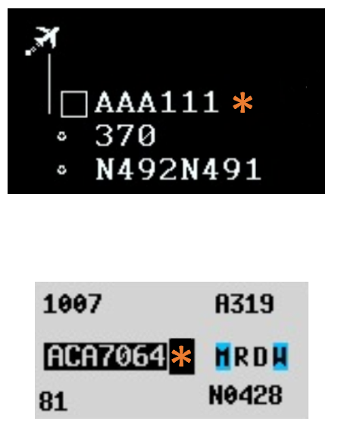
Air Traffic Improvements
A visual indication will be displayed to a controller when an aircraft operating over a degraded path is encountering delayed messages
Suppression of Outage Related Sector Queue Messages during an outage/degradation.
No Link delivery confirmation
Contract request timed out
ADS Report Overdue
SVC messages reporting - “UNABLE TO PROCESS – MESSAGE TOO OLD

Slide 21
Tech Ops Improvements
Ability to view/monitor the status of a ground station
Ability to identify if a degradation is ground station specific or potentially linked to a SSP/DSP
Ability to view/monitor network traffic of messages
Ability to view/monitor flights actively sending messages through a ground station
Ability to view/monitor flights that are receiving delayed messages.
Ability to view/monitor impacts to controlling sectors

Slide 22
Network Outage Detection and Reporting(NODAR) Project Team

Slide 23
Network Outage Detection and Reporting (NODAR) Project Team
Project Title | NAT Network Outage Detection and Reporting (NODAR)
Parent Group | NAT TIG
Project Supervisory body | NAT TIG
Project Period | April 2018 – March 2019
Project Objective | To improve the detection and reporting related to outages at the communication service provider (CSP) and satellite service provider (SSP) system levels, in order to minimize the impacts of outages on the safety and efficiency of the application of performance-based separation standards, and ultimately improve the network availability.
Project Outcomes: | An action plan with defined methods to: better detect outage conditions within the CSP and SSP systems, and report in a more standardized and constructive manner to the air navigation service providers (ANSPs) and operators during outage situations.
Membership | NAT TIG, Inmarsat, Iridium, ARINC, SITA Note: Other subject matter experts may also participate, as deemed appropriate by the Project Team.
Coordination Requirements | NAT TIG, NAT POG, NAT CMA, NAT DLMA
Project High level Tasks | Review existing processes for detection and reporting of outages. Identify known causes for outages in the CSP/SSP sub-systems and CSP/SSP, CSP/ANSP interfaces. Identify ways to improve detection and related feasibility. Identify ways to standardize and improve notifications provided to ANSPs and operators during outage conditions. Identify potential documentation that may require amendments to reflect results of this project team. Report to NAT TIG/7.
Project Lead | Theresa Brewer, United States
Project Secretariat Support | ICAO EUR/NAT Office

Slide 24
Still working on…
Getting a list of services with standard, clear nomenclature agreed between CSPs and SSPs
Establishing an agreed template for email notification to be used by all CSPs when reporting to ATSPs
Obtaining information from CSPs as to what it will take to implement changes based on the agreements, and when they would be able to implement

