Slide 1
COLLINS AEROSPACE Update on SatVoice Implementation
April 2023
Prepared for ISPACG

Slide 2
SatVoice one stage dialing
Implementation update
Collins Aerospace has been implementing a closed-loop Voice over IP network to support implementation of SatVoice one-stage dialing in U.S. Airspace for Air Traffic Services
The network is intentionally diverse from the Collins datalink infrastructure to ensure diversity from FANS
The system uses the Session Initiation Protocol (SIP) for call setup and telephony signaling, a widely used telephony protocol but configured to include octal and priority call elements

Slide 3
Results
Initial results – lab testing
Audio latency reduced about 10% from 0.89 sec to 0.80 sec
Observed during testing w/Inmarsat. Iridium testing is forthcoming.
GtA call setup time reduced from 20 sec to < 1 sec
PSTN setup was observed from 2019 Pacific Voice Trials

Slide 4
One stage dialing - Current state
Verizon
Islip, New York (NYC)
Comm Center
Livermore (SFO)
Comm Center
New York
Tempe 1
Iridium
Inmarsat
SIP Core
Annapolis, MD

Slide 5
One stage dialing - future state
Verizon
Islip, New York (NYC)
Comm Center
Livermore (SFO)
Comm Center
Telco 2
New York
Tempe 1
Amsterdam
Tempe 2
Iridium
Inmarsat
SIP Core
Annapolis, MD

Slide 6
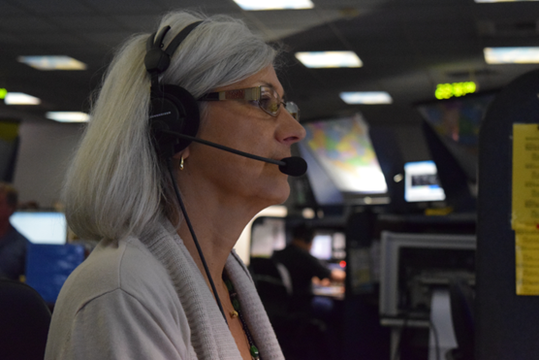
Phase I Trials
FedEx over Inmarsat callback checks
Iridium equipped aircraft to be added in the future
Callback checks only, no ATC
Test short codes map to VoIP network
Live short codes continue routing through PSTN
Objective is to exercise the system and collect hundreds or thousands of calls
Single server at Collins core, single network connections to core nodes
Success criteria to move to Phase II?
No unresolved trouble tickets
Number of one-stage calls? AtG, GtA, Iridium/Inmarsat?

Slide 7
Phase II Trial
(Under Development)
Limited ATC use authorized by FAA for ATC to a limited number of trial participants
Callback check in conjunction with SELCAL check and HF frequency assignment
Use test short code or move operation short code to SIP?
Success criteria to move to go-live
Collins has redundant SIP services at Annapolis core
All core nodes have redundant network connections
No unresolved trouble tickets
Number of calls

