Slide 1
37th Meeting of the Informal South Pacific Air Traffic Services Coordinating Group (ISPACG/37)
Monitoring Agency Activities in South Pacific Airspace

Slide 2
Overview
Pacific Approvals Registry and Monitoring Organization (PARMO)
Annual reports to RASMAG/27
Action for the Meeting (Reminders)

Slide 3
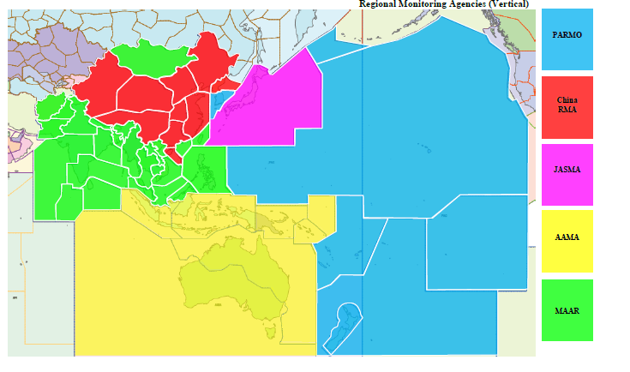
Monitoring Agencies for Pacific Airspace
China RMA
JASMA
PARMO
MAAR
AAMA

Slide 4
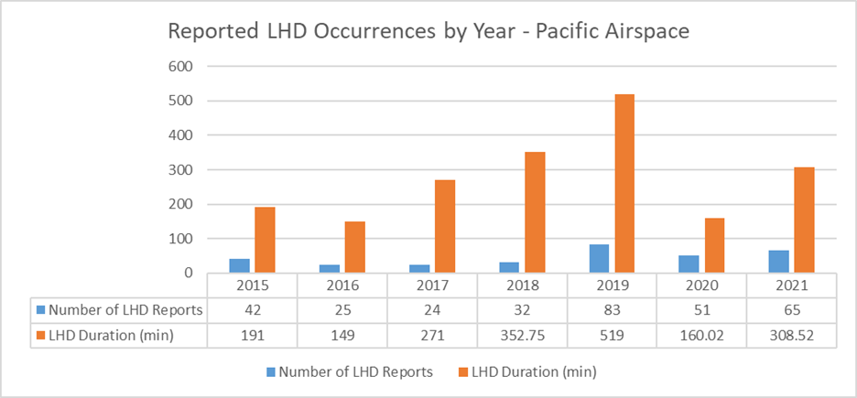
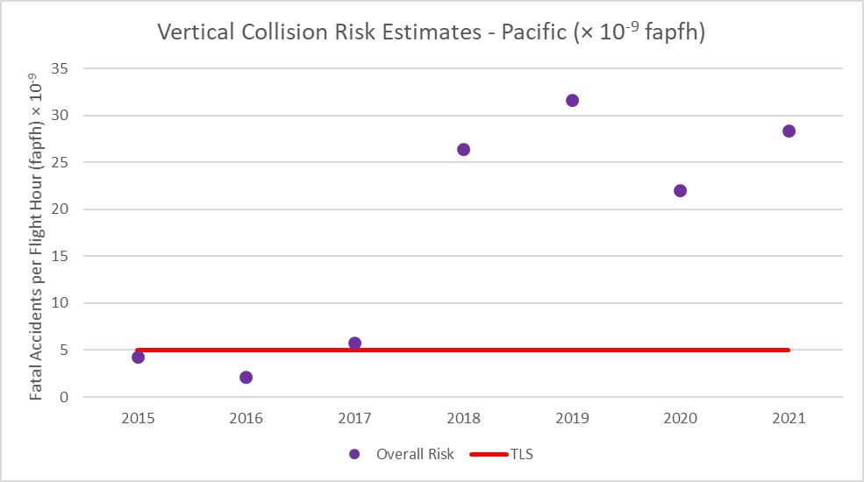
PARMO Summary of Vertical Collision Risk Estimates

Slide 5
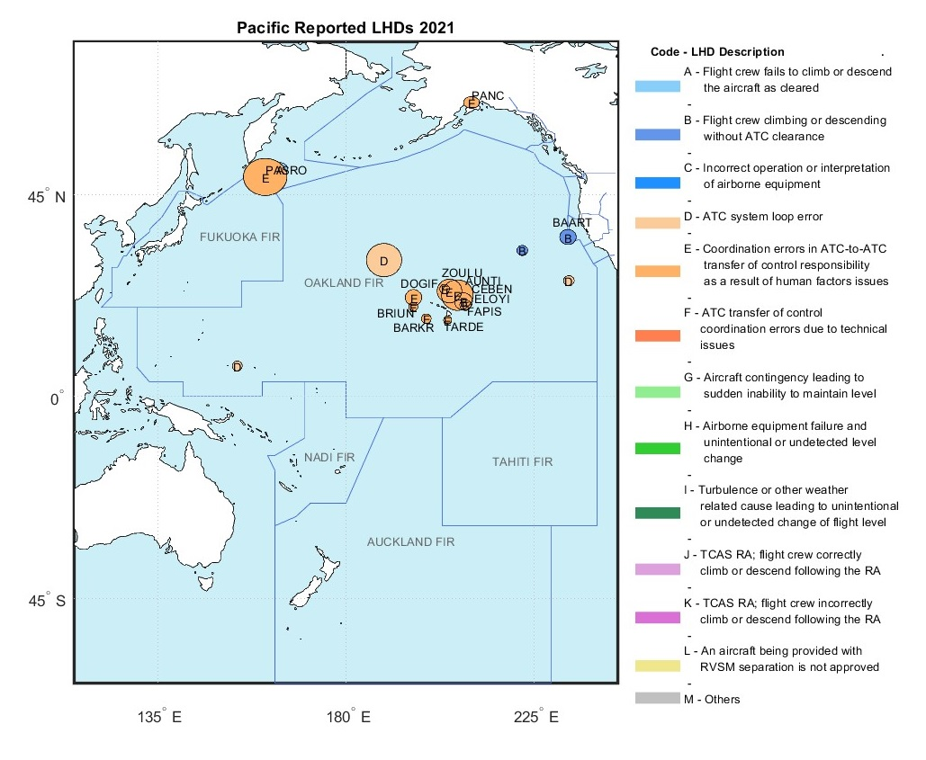
Vertical Occurrence Reports Submitted to PARMO (RASMAG/27)
Most occurrence reports involved ATC-unit to ATC-unit transitions

Slide 6
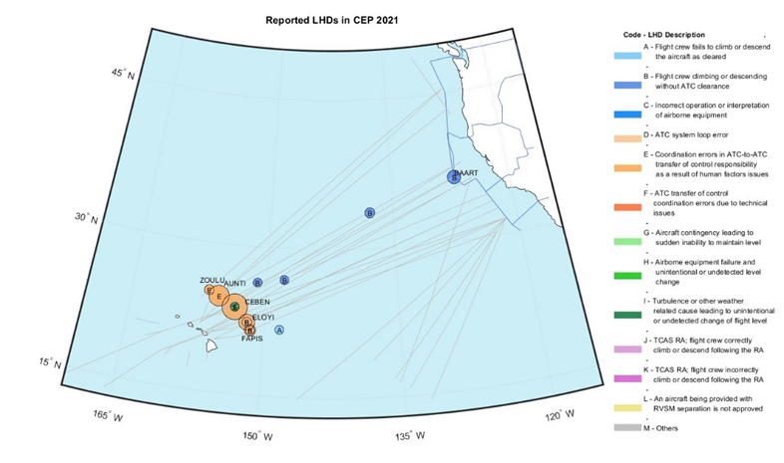
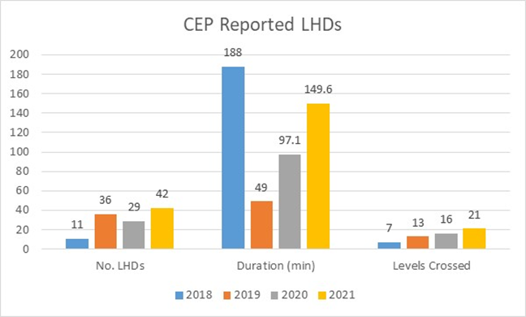
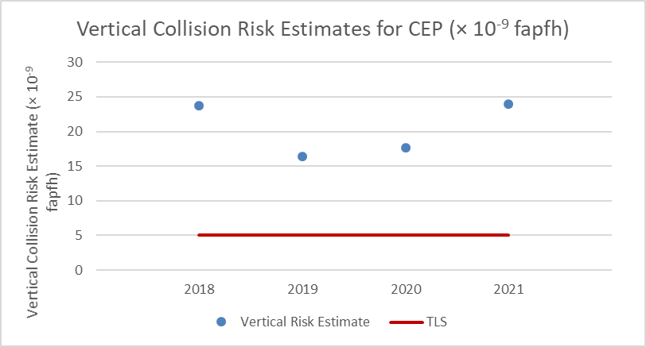
RASMAG “Hot Spot” Updates
Hot Spot N, Central East Pacific (CEP) area between North America and Hawaii [2021 – category E LHDs increasing]
 | 2019 | 2020 | 2021
Flying hours | 425,950 | 215,009 | 461,990
Number of flights | 115,543 | 63,661 | 128,927
% Data link | 69.1 % | 81.8% | 83.8%
% HF (only) | 30.9 % | 18.2% | 16.2%
% RNP4, RCP240, & RSP180 filing | 31.4 % | 52.2% | 69.3%

Slide 7
Action for the Meeting
Ensure ANSPs/States
  Provide annual traffic sample data to the designated RMA
  Provide vertical, lateral, and longitudinal occurrence reports to PARMO (internal investigation reports can be attached)
    Key information for these occurrence reports to help determine underlying causal factors and duration/magnitude
      Location of the occurrence
      Summary/narrative
      Relevant time stamps
      ADS-C reports
      CPDLC messages
      Any corrective action/mitigation introduced as a result of the occurrence

Slide 8
Questions? parmo@faa.gov
Christine Falk Christine.falk@faa.gov

